Slide 1
Notes:
Project managers in charge of a single small project can plan and schedule the project tasks without much formal planning and information. However, when the project manager must manage several small projects or a large complex project, a threshold is quickly reached in which the project manager can no longer cope with the detail.

Slide 2
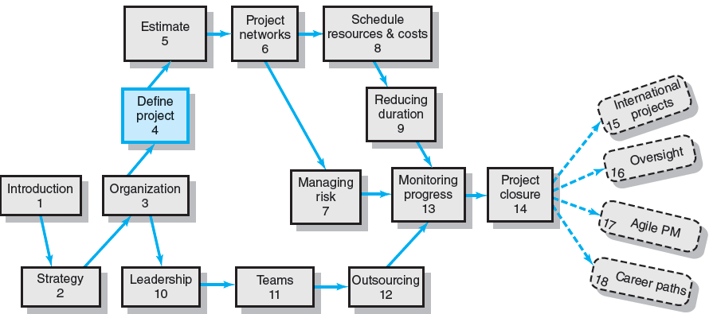
Where We Are Now
Notes:
Chapter 4 describes the work breakdown structure (WBS) for selectively collecting information to use during the project’s life cycle, to meet stakeholder needs, and to measure project performance against the organization’s strategic plan.
In addition, the chapter examines the process breakdown structure as well as responsibility matrices used for smaller, less complex projects. The chapter concludes with the process of creating a communication plan for coordinating project activities and following the progress of a project.

Slide 3
Defining the Project
Step 1: Defining the Project Scope
Step 2: Establishing Project Priorities
Step 3: Creating the Work Breakdown Structure
Step 4: Integrating the WBS with the Organization
Step 5: Coding the WBS for the Information System
Notes:
These five generic steps provide a structured approach to collecting the project information needed for developing a work breakdown structure all take place concurrently, and several iterations are typically required to develop dates and budgets that can be used to manage the project. However, defining the project is always the first and, perhaps, most important step.

Slide 4
Step 1: Defining the Project Scope
Project Scope
A definition of the end result or mission of the project—a product or service for the client/customer—in specific, tangible, and measurable terms.
Purpose of the Scope Statement
To clearly define the deliverable(s) for the end user.
To focus the project on successful completion of its goals.
To be used by the project owner and participants as a planning tool and for measuring project success.
Notes:
Defining the project scope sets the stage for developing a project plan. Project scope is a definition of the end result or mission of your project—a product or service for your client/customer. The primary purpose is to define as clearly as possible the deliverable(s) for the end user and to focus project plans. In essence, project managers must begin with the desired end results in mind and create a scope document that outlines clearly the steps to achieve those results in specific, tangible, and measurable terms.

Slide 5
Project Scope Checklist
Project objective
Deliverables
Milestones
Technical requirements
Limits and exclusions
Reviews with customer
Notes:
Defining project scope is the keystone that interlocks all elements of a project plan. To ensure that scope definition is complete, project managers should use a checklist that helps assure the project is properly focused on its intended purpose/objectives, boundaries, and outcomes by defining what project activities will and will not involve.

Slide 6
Project Scope: Terms and Definitions
Scope Statements
Also called statements of work (SOW)
Project Charter
Can contain an expanded version of scope statement
A document authorizing the project manager to initiate and lead the project.
Scope Creep
The tendency for the project scope to expand over time due to changing requirements, specifications, and priorities.
Notes:
Scope statements are also called statements of work. A project charter refers to a document issued by upper management that authorizes the project manager to initiate and lead the project.
Scope creep is the expansion of the project over time due to changing requirements, specifications, and priorities. Scope creep is reduced by writing a scope statement that is not so broad as to be an invitation for scope creep which can result in cost overruns, delays and, in serious instances, project failure.

Slide 7
Step 2: Establishing Project Priorities
Causes of Project Trade-offs
Shifts in the relative importance of criterions related to cost, time, and performance parameters
Budget–Cost
Schedule–Time
Performance–Scope
Managing the Priorities of Project Trade-offs
Constrain: a parameter is a fixed requirement.
Enhance: optimizing a criterion over others.
Accept: reducing (or not meeting) a criterion requirement.
Notes:
Project managers must deal with changing project criteria and priorities by constraining, enhancing, or accepting certain trade-offs related to changes in available resources, schedule alterations, and expected performance requirements.

Slide 8
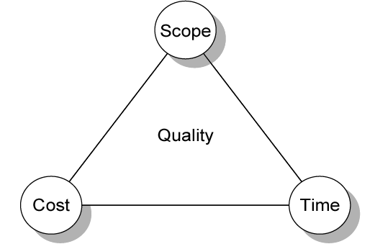
Project Management Trade-offs
FIGURE 4.1
Notes:
Figure 4.1 illustrates effect that trade-offs in relationships among cost (budget), time (schedule), and performance (scope) of a project have on project success in meeting and/or exceeding the quality expectations of the customer and/or upper management.

Slide 9
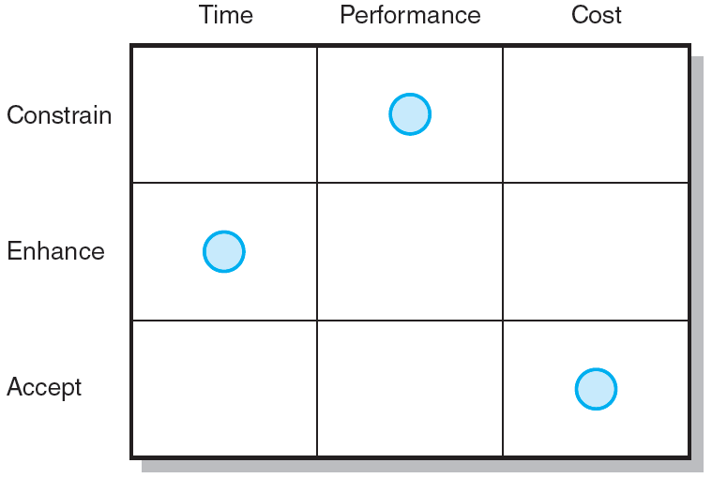
Project Priority Matrix
FIGURE 4.2
Notes:
Figure 4.2 displays the priority matrix for the development of a new wireless modem. Because time to market is important to sales, the project manager must focus on reducing product development time. Exceeding the development budget is acceptable, although product performance specifications such as reliability standards cannot be compromised.

Slide 10
Step 3: Creating the Work Breakdown Structure
Work Breakdown Structure (WBS)
An hierarchical outline (map) that identifies the products and work elements involved in a project.
Defines the relationship of the final deliverable (the project) to its subdeliverables, and in turn, their relationships to work packages.
Best suited for design and build projects that have tangible outcomes rather than process-oriented projects.
Notes:
The work breakdown structure (WBS).successively subdivides the work of the project into a outline that is a detailed hierarchical structure of smaller and smaller work elements,. A proper WBS identifies all products and work elements, integrates the project with its organization, and establishes a basis for controlling the project.

Slide 11
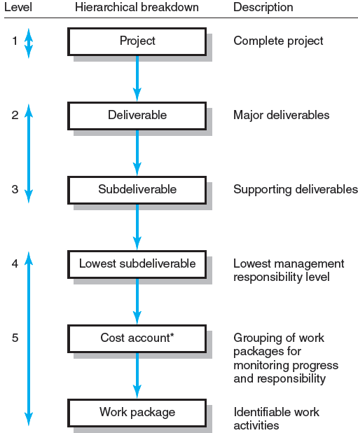
Hierarchical Breakdown of the WBS
* This breakdown groups work packages by type of work within a deliverable and allows assignment of responsibility to an organizational unit. This extra step facilitates a system for monitoring project progress (discussed in Chapter 13).
FIGURE 4.3
Notes:
Figure 4.3 shows the major groupings used to develop a hierarchical WBS. The WBS begins with the project as the final deliverable. Project work is then successively divided into increasingly smaller-sized subdeliverables to facilitate monitoring of project progress by work, cost, and responsibility.

Slide 12
How WBS Helps the Project Manager
WBS
Facilitates evaluation of cost, time, and technical performance of the organization on a project.
Provides management with information appropriate to each organizational level.
Helps in the development of the organization breakdown structure (OBS). which assigns project responsibilities to organizational units and individuals
Helps manage plan, schedule, and budget.
Defines communication channels and assists in coordinating the various project elements.
Notes:
Systematically breaking down the work of a project into a hierarchy of all of its elements facilitates control and evaluation by project managers of the cost, time, and technical performance of a project over its life.

Slide 13
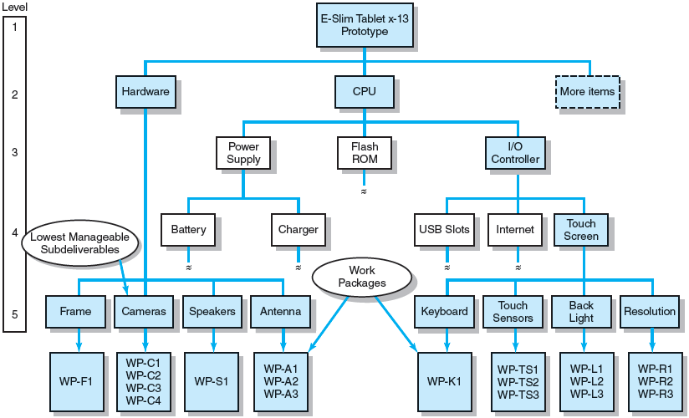
Work Breakdown Structure
FIGURE 4.4
Notes:
Figure 4.4 shows the several different hierarchical levels of a simplified WBS to develop a new prototype tablet computer. The levels of the structure can also represent information available to use by different levels of management.

Slide 14
Work Packages
A work package is the lowest level of the WBS.
It is output-oriented in that it:
Defines work (what).
Identifies time to complete a work package (how long).
Identifies a time-phased budget to complete a work package (cost).
Identifies resources needed to complete a work package (how much).
Identifies a person responsible for units of work (who).
Identifies monitoring points (milestones) for measuring success.
Notes:
As the lowest level of the WBS, the work package is the basic unit used for planning, scheduling, and controlling a project. Work packages help define the WBS structure by keeping it end-item and output-oriented.

Slide 15
Step 4: Integrating the WBS with the Organization
Organizational Breakdown Structure (OBS)
Depicts how the firm is organized to discharge its work responsibility for a project.
Provides a framework to summarize organization work unit performance.
Identifies organization units responsible for work packages.
Ties organizational units to cost control accounts.
Notes:
The organizational breakdown structure (OBS) depicts how a firm assigns organizational unit work responsibility. The OBS framework summarizes unit work performance, identifies units responsible for work packages, and ties units to cost control accounts

Slide 16
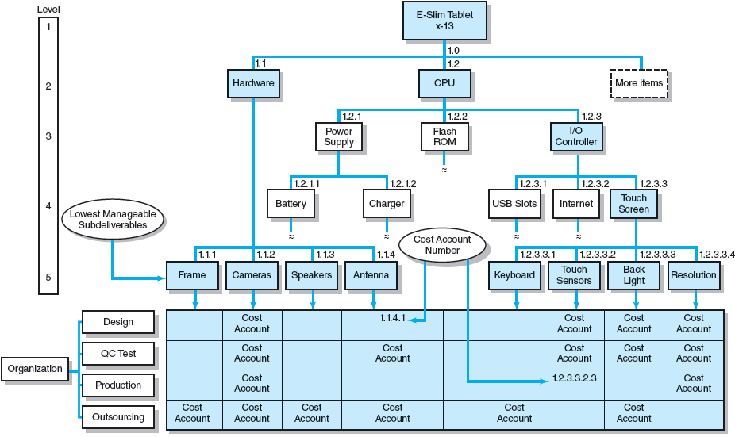
Integration of WBS and OBS
FIGURE 4.5
Notes:
Figure 4.5. illustrates how the intersection of work packages and the organizational unit creates a project control point (cost account) that integrates work and responsibility for a tablet computing device. The intersection of the WBS and OBS represents the set of work packages necessary to complete the subdeliverable located immediately above and the organizational unit on the left responsible for accomplishing the packages at the intersection.

Slide 17
Step 5: Coding the WBS for the Information System
WBS Coding System
Defines:
Levels and elements of the WBS
Organization elements
Work packages
Budget and cost information
Allows reports to be consolidated at any level in the organization structure
Notes:
Gaining the maximum usefulness of a breakdown structure depends on a coding system. The codes define levels and elements in the WBS, organization elements, work packages, and budget and cost information to allow allow reports to be consolidated at any level in the structure.

Slide 18
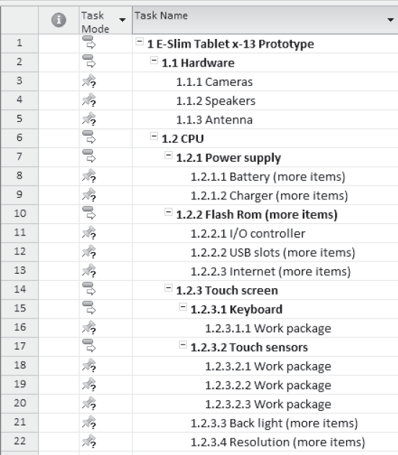
Coding the WBS
EXHIBIT 4.5
Notes:
Exhibit 4.5 presents numeric indentation coding for a portion of the WBS for the E-Slim Tablet x-13 Prototype project. Each successive indention represents a lower element or work package. The numeric scheme extends to the work package level, and all tasks and elements in the structure have an identification code

Slide 19
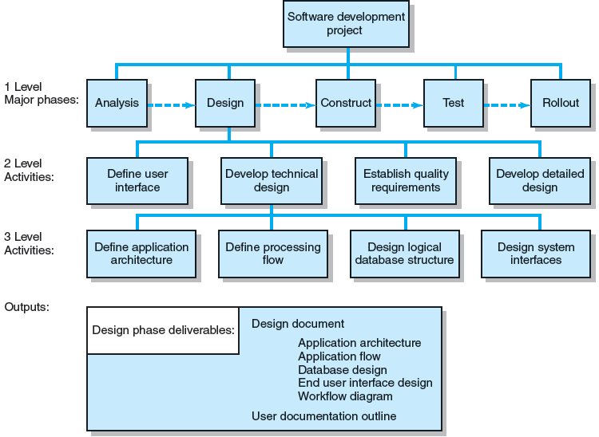
PBS for Software Development Project
FIGURE 4.6
Notes:
Figure 4.6 provides an example of a PBS for a software development project organized around phases. Each of its five major phases is broken down into more specific activities until enough detail emerges about what needs to be done to complete that phase.

Slide 20
Responsibility Matrices
Responsibility Matrix (RM)
Also called a linear responsibility chart.
Summarizes the tasks to be accomplished and who is responsible for what on the project.
Lists project activities and participants.
Clarifies critical interfaces between units and individuals that need coordination.
Provide an means for all participants to view their responsibilities and agree on their assignments.
Clarifies the extent or type of authority that can be exercised by each participant.
Notes:
A responsibility matrix (RM) is a tool widely used by project managers and task force leaders of small projects where the size and scope of the project do not warrant an elaborate WBS or OBS. The RM (also called a linear responsibility chart) summarizes tasks to be accomplished and who is responsible for what on a project.
Responsibility matrices allow all participants in a project to view their responsibilities and agree on their assignments. The matrices clarify the extent or type of authority exercised by each participant in performing an activity in which two or more parties have overlapping involvement.

Slide 21
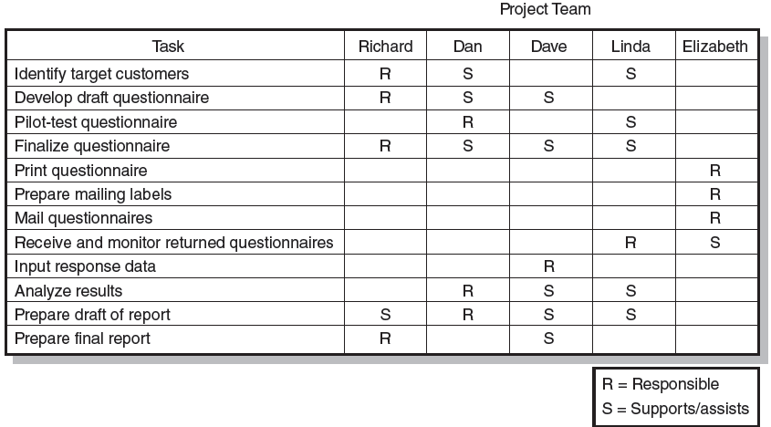
Responsibility Matrix for a Market Research Project
FIGURE 4.7
Notes:
Figure 4.7 illustrates a Responsibility Matrix for a market research study. The R identifies the committee member who is responsible for coordinating the efforts of other team members assigned to the task and making sure that the task is completed. The S identifies members of the five-person team who will support and/or assist the individual responsible.

Slide 22
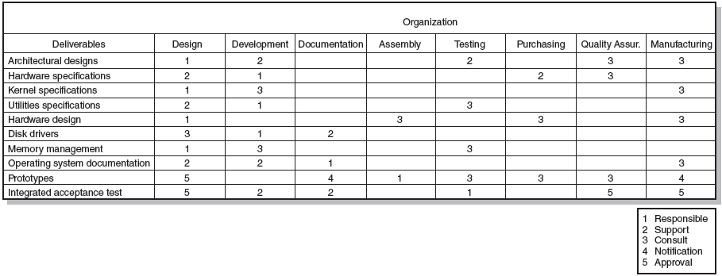
Responsibility Matrix for the Conveyor Belt Project
FIGURE 4.8
Notes:
Figure 4.8 is a Responsibility Matrix ((RM) for a larger, more complex project to develop a new piece of automated equipment. Within each cell a numeric coding scheme defines the nature of involvement on that specific task. The RM extends the project’s WBS/OBS and provides a clear and concise method for depicting responsibility, authority, and communication channels for the project.

Slide 23
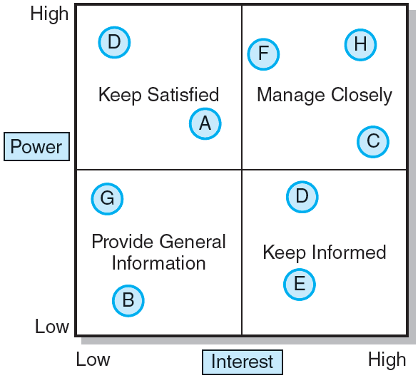
Stakeholder Communications
FIGURE 4.9
Notes:
Figure 4.9 presents a “Power/Interest” map that can be used to prioritize major project stakeholders’ communication needs by the type and frequency of communication required.

Slide 24
Project Communication Plan
What information needs to be collected and when?
Who will receive the information?
What methods will be used to gather and store information?
What are the limits, if any, on who has access to certain kinds of information?
When will the information be communicated?
How will it be communicated?
Notes:
The purpose of a project communication plan is to express what, who, how, and when information will be transmitted to project stakeholders so schedules, issues, and action items can be tracked.
Project communication plans should address the following core questions:
• What information needs to be collected and when?
• Who will receive the information?
• What methods will be used to gather and store information?
• What are the limits, if any, on who has access to certain kinds of information?
• When will the information be communicated?
• How will it be communicated?

Slide 25
Information Needs
Project status reports
Deliverable issues
Changes in scope
Team status meetings
Gating decisions
Accepted request changes
Action items
Milestone reports
Notes:
Different project stakeholders have different information needs. Internal stakeholders may require frequent and detailed project progress information while external stakeholders will need more or less detailed and frequent communications depending the extent of their direct involvement with the project.

Slide 26
Developing a Communication Plan
Stakeholder analysis
Information needs
Sources of information
Dissemination modes
Responsibility and timing
Notes:
The advantage of establishing a communication plan is that the plan provides the project manager with greater autonomy in controlling the flow of information to reduce confusion and unnecessary interruptions. By reporting on a regular basis how things are going and what is happening, senior management is less inclined to interfere with the team’s work on the project.

Slide 27
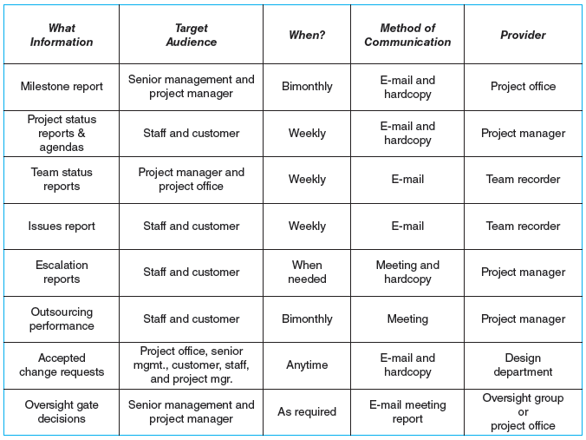
Shale Oil Research Project Communication Plan
FIGURE 4.10
Notes:
Figure 4.10 provides a sample Shale Oil Research Project Communication Plan that addresses the core questions to be considered when establishing a communication plan. It includes what information is needed, who is the target audience, when the information is needed, method of communication, and the provider of the information.

Slide 28
Key Terms
Cost account
Milestone
Organization breakdown structure (OBS)
Priority matrix
Process breakdown structure (PBS)
Project charter
Responsibility matrix
Scope creep
Scope statement
WBS dictionary
Work breakdown structure (WBS)
Work package
Notes:
Cost account is a project control point created by the intersection of work packages and the organizational unit.
Milestone is an event that represents significant, identifiable accomplishment toward the project’s completion.
The organization breakdown structure (OBS) depicts how the firm has organized to discharge work responsibility.
A project priority matrix identifies which criterion is constrained, which should be enhanced, and which can be accepted.
A process breakdown structure (PBS) is a phase-oriented grouping of project activities that defines the total scope of the project.
Project charter is a document that authorizes the project manager to initiate and lead a project.
A responsibility matrix shows the relationship between an activity (work package) and the person/group responsible for its completion.
Scope creep is the tendency for the scope of a project to expand once it has started.
Scope statement is a definition of the end result or mission of a project.
Work breakdown dictionary provides detailed information about each element in the WBS.
Work breakdown structure (WBS) is a hierarchical method that successively subdivides the work of the project into smaller detail.
Work package is a task at the lowest level of the WBS.

